Slide 1


HOTEL MANAGEMENT SOLUTIONS
Hotel Management System
•Final Project – Database II
•Prepared by the team 3

Slide 2
Project Overview
•A database-driven system to
manage hotel operations
•Designed using Oracle SQL and PL/SQL

Slide 3
System Objectives
Manage hotel users and guests
Handle reservations and room allocation
Manage billing and services efficiently

Slide 4
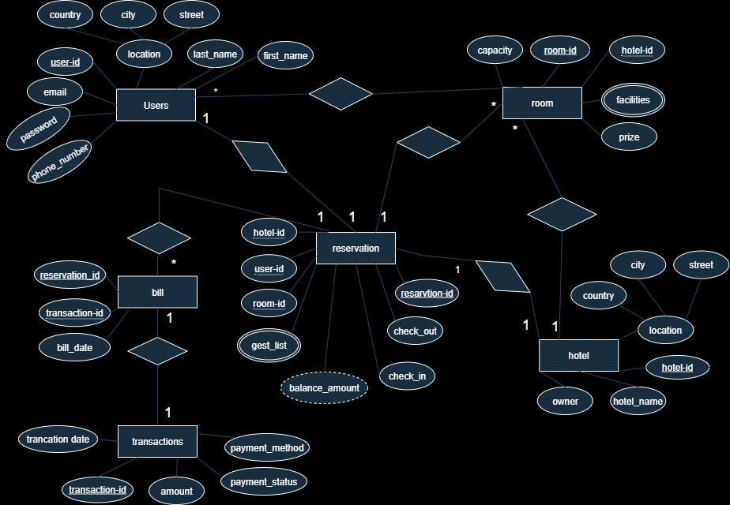

Slide 5
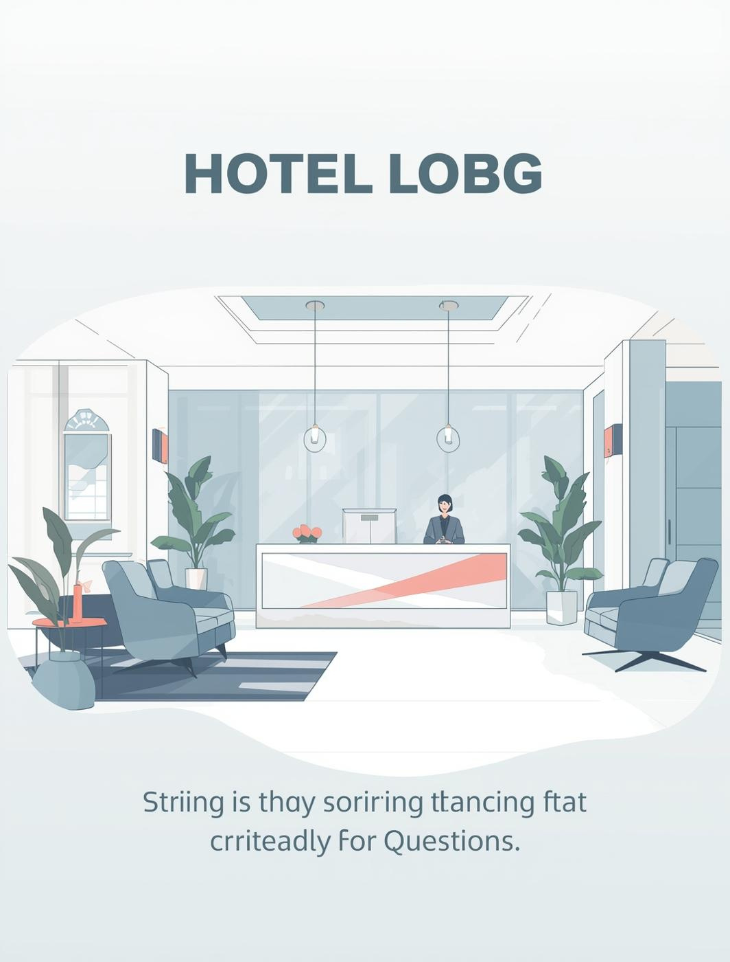
System Modules
User Management
Room Management
Reservation Management
Billing

Slide 6
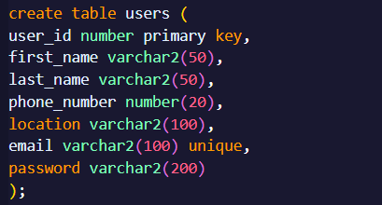
MAIN TABLE

Slide 7
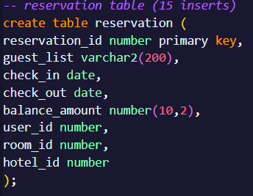

Slide 8
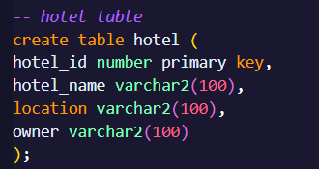

Slide 9
Database Design
Relational database design
Primary Keys and Foreign Keys
Ensures data integrity

Slide 10
PL/SQL Packages
PROCEUDER AND FUNCTION

Slide 11
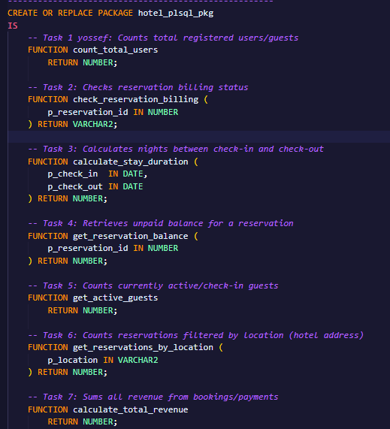

Slide 12
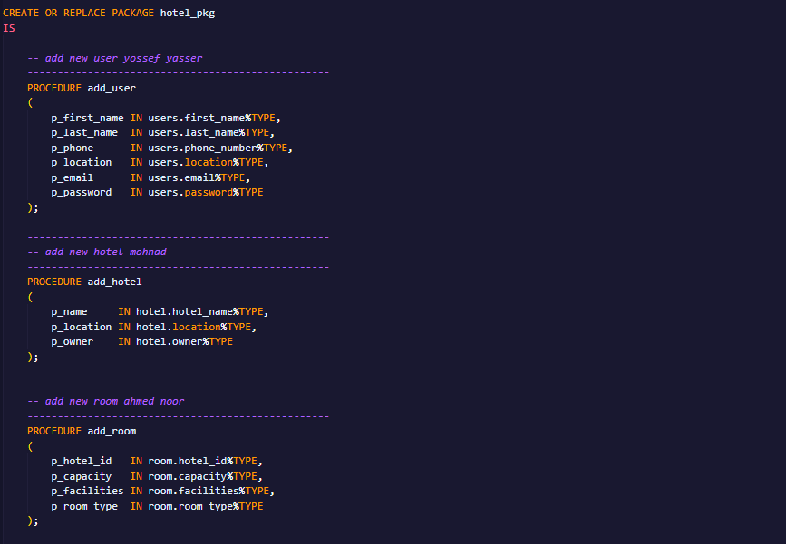

Slide 13
Stored Procedures
Add and delete users
Create and cancel reservations
Process billing operations

Slide 14
Functions
Count total users
Check billing status
Calculate stay duration

Slide 15
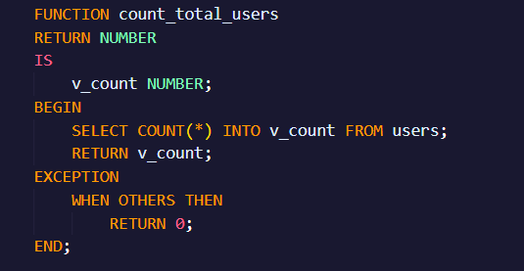

Slide 16
Triggers
Before INSERT trigger
After UPDATE trigger
After DELETE trigger

Slide 17
Technologies Used
Oracle SQL
PL/SQL
SQL Developer

Slide 18
Technologies Used
Oracle SQL
PL/SQL
SQL Developer

